Slide 1






Medical Profile Application
Team members:
Cota Andrei
Nita Andrei
Pasare Alexandra

Slide 2
Application Description
The goal of the application is to make the communication between the hospital personnel and the patients easier. The application is a database based web application:
all the data is stored in a database
changes are made through the User Interface
patients are able to access their data through the User Interface

Slide 3
Application Description
The application is personalized for each hospital according to their requirements and specializations.
The database will contain the records of all the patients and every patient and doctor will have an account created.

Slide 4
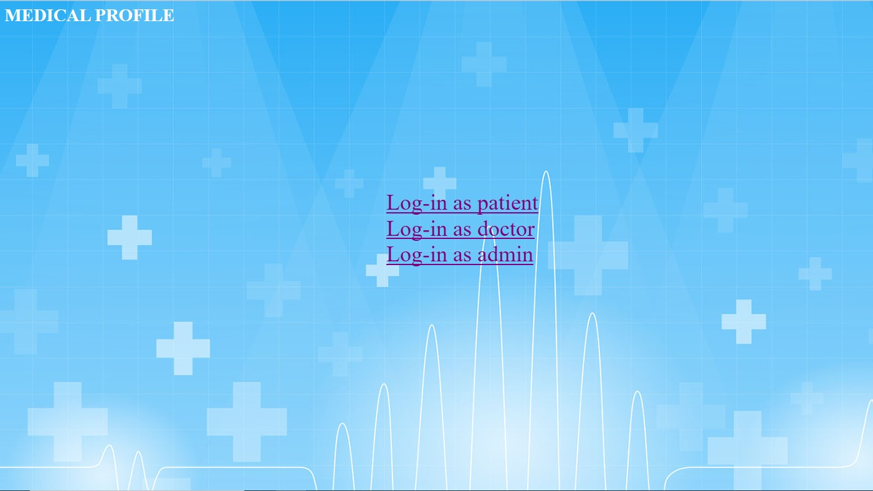
This is the first page that the user sees when the application starts.

Slide 5
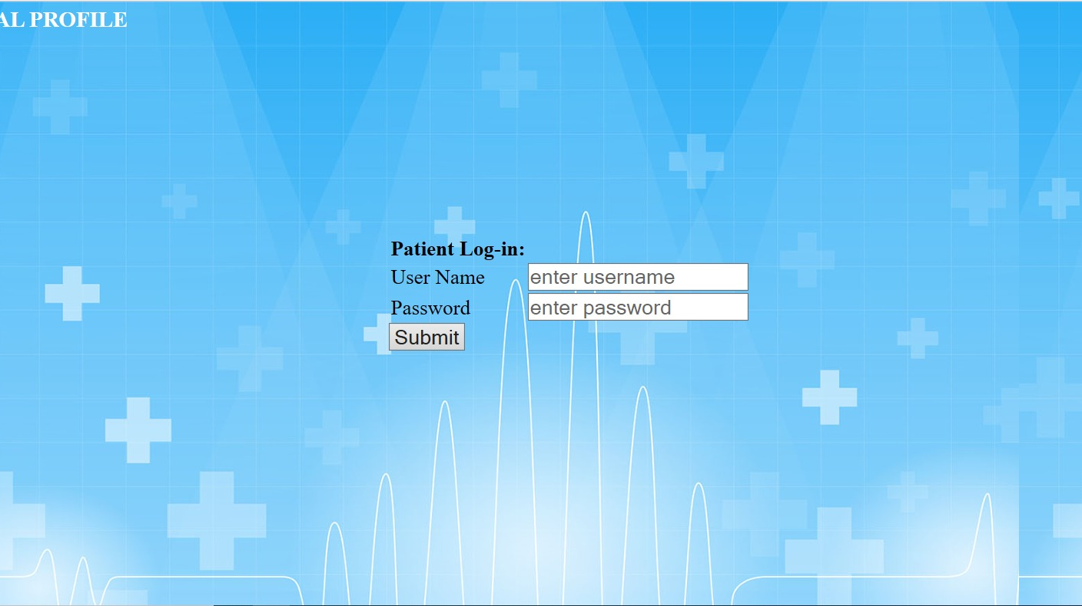
Patient Log-in page

Slide 6
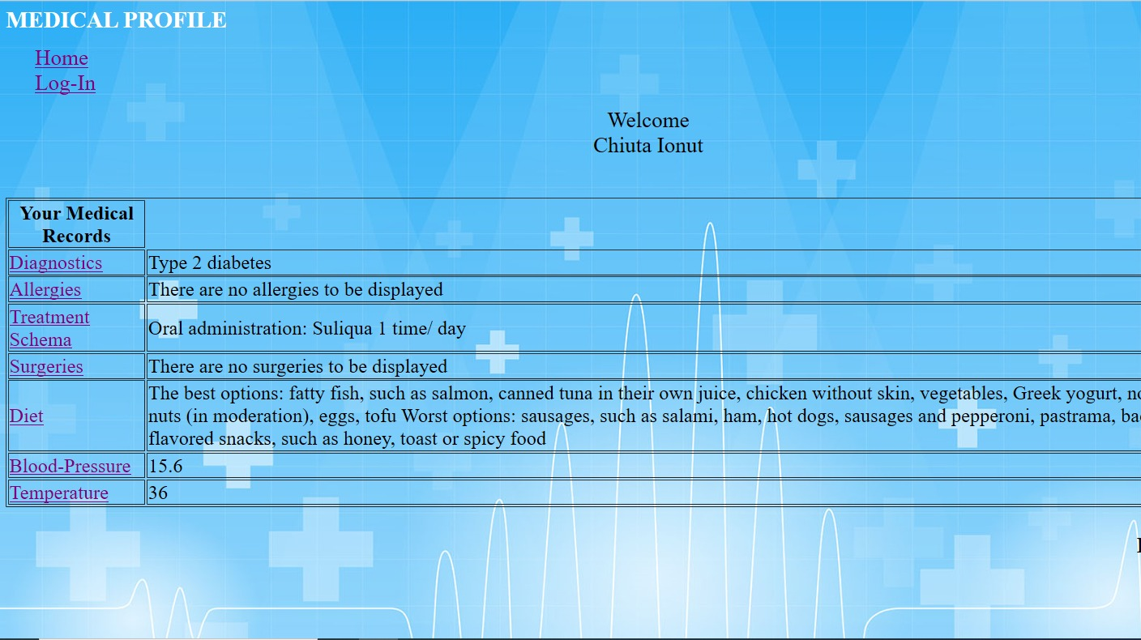
This is the first page that the user sees when the application starts.

Slide 7
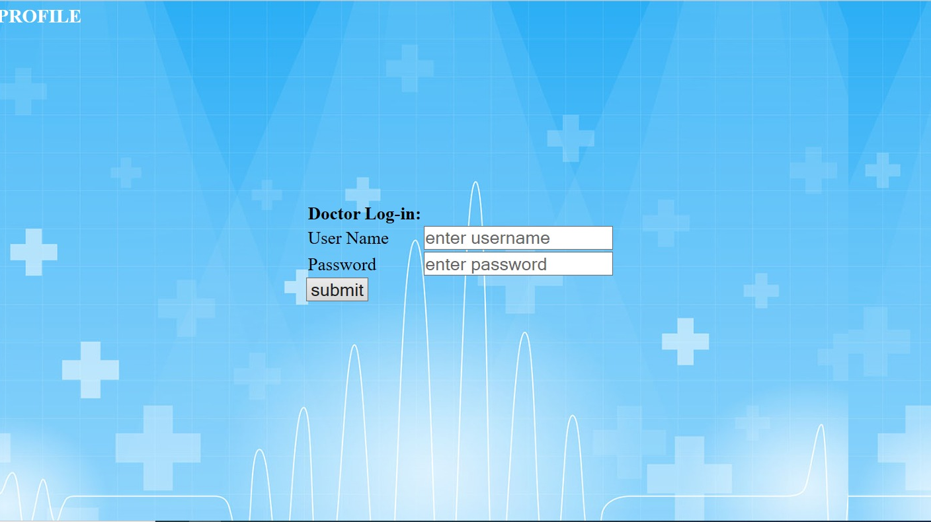
Doctor Log-in page

Slide 8
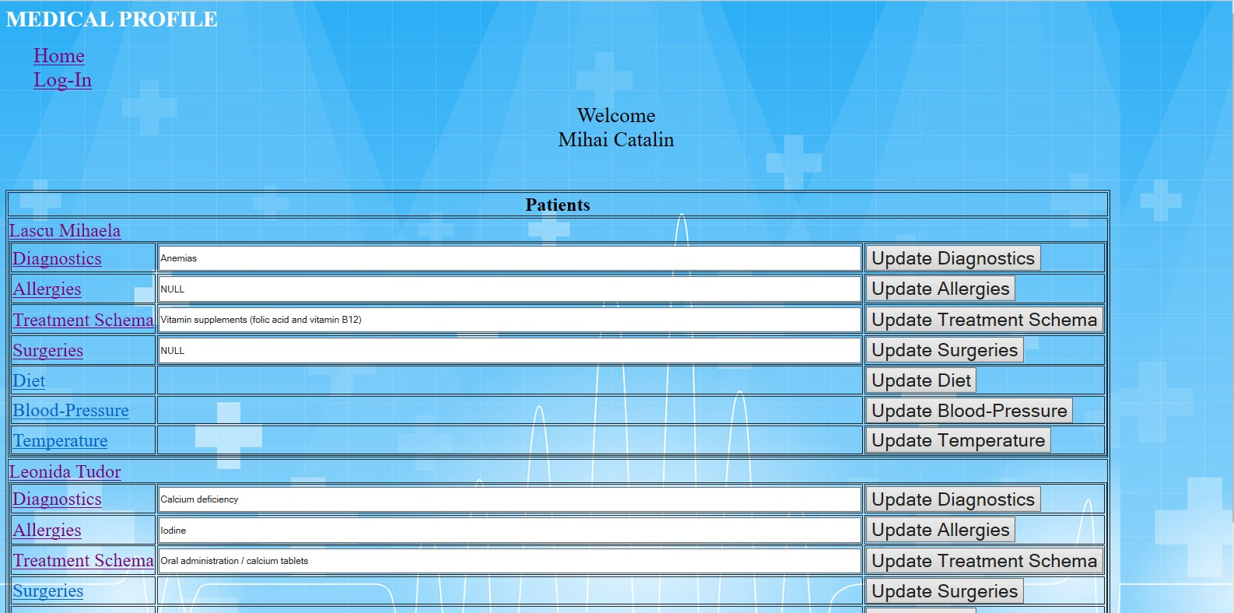

Slide 9
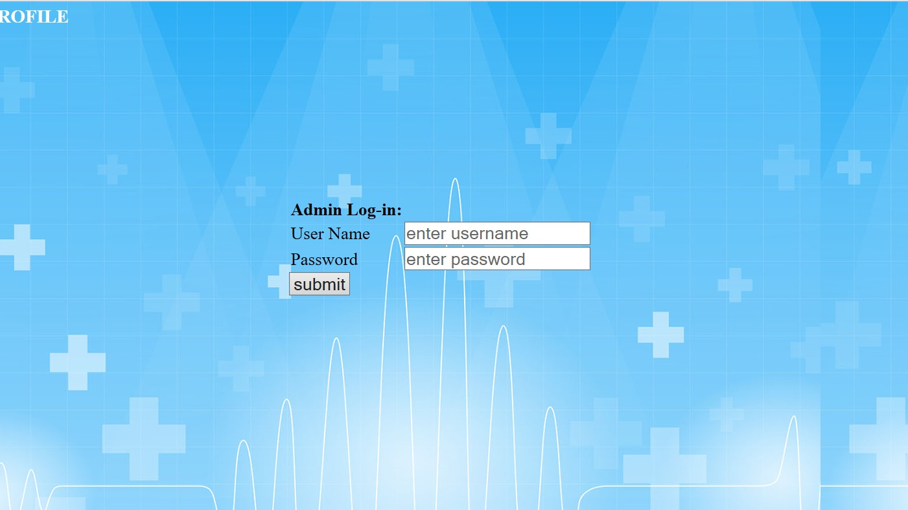
Admin Log-in page

Slide 10
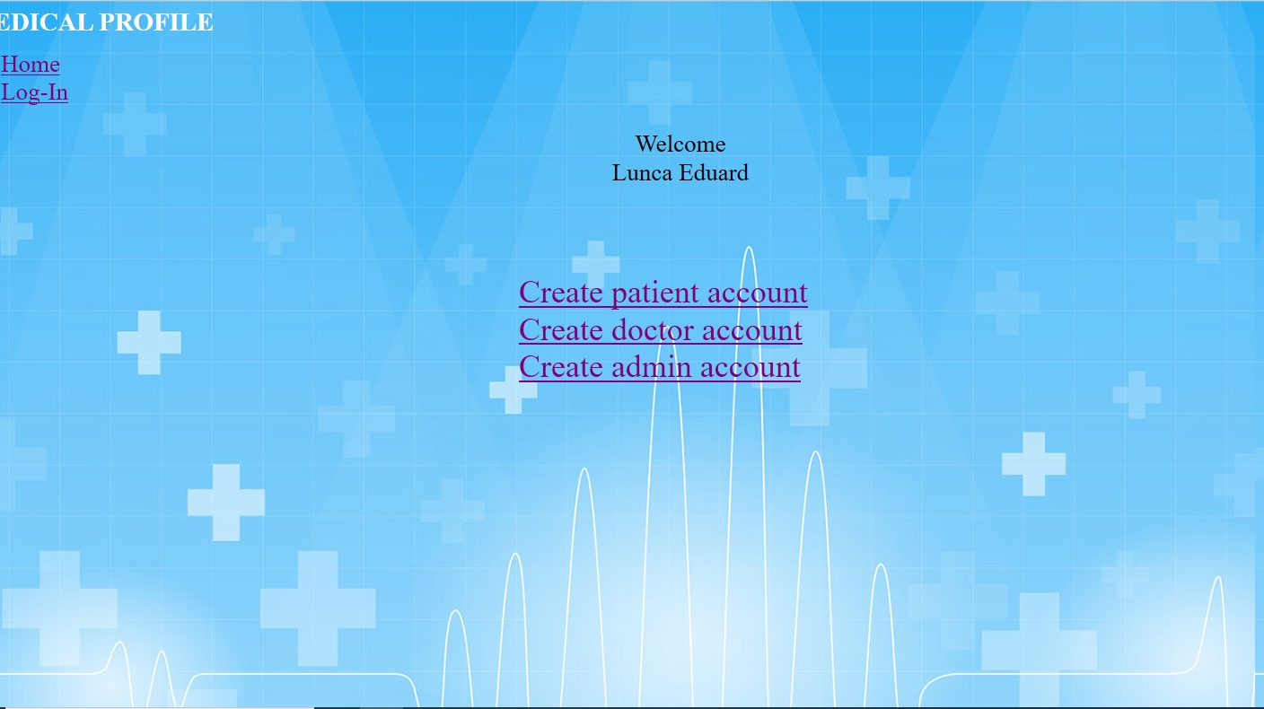
The admin is the only one who can create an account.

Slide 11
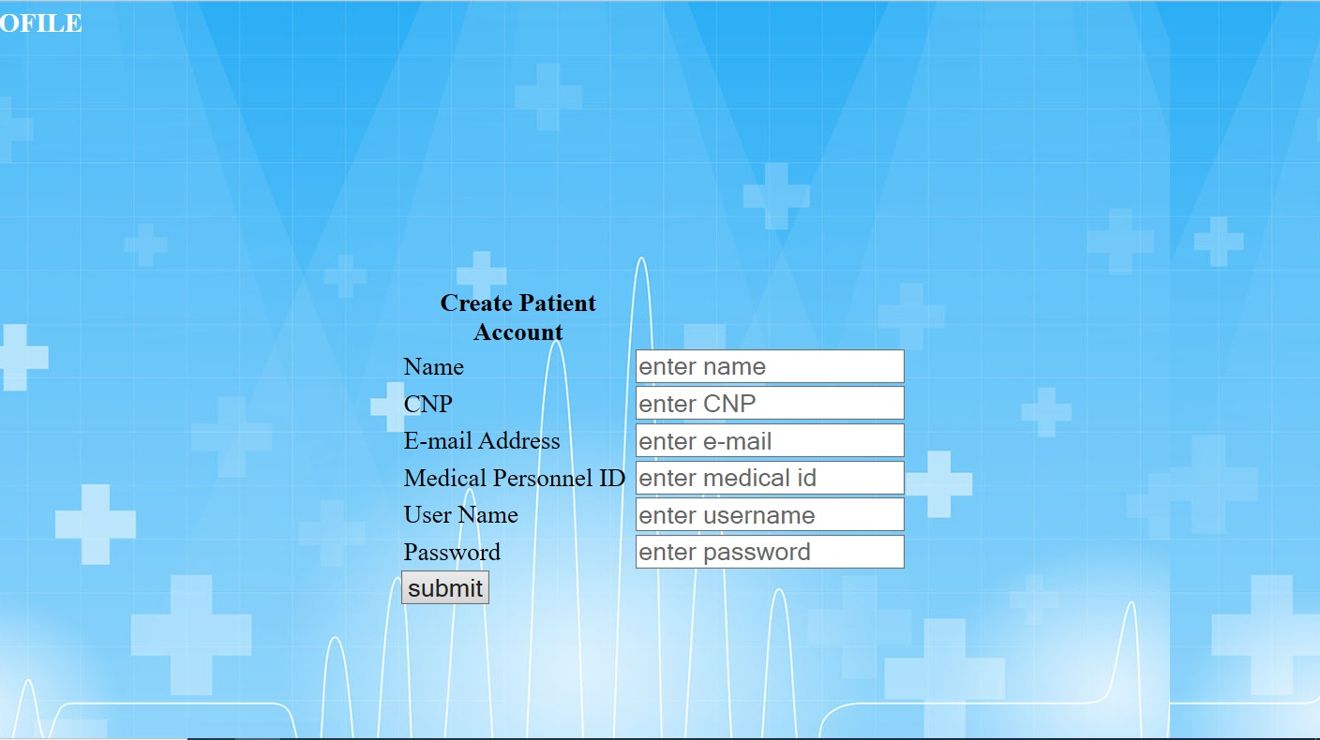
Create patient account

Slide 12
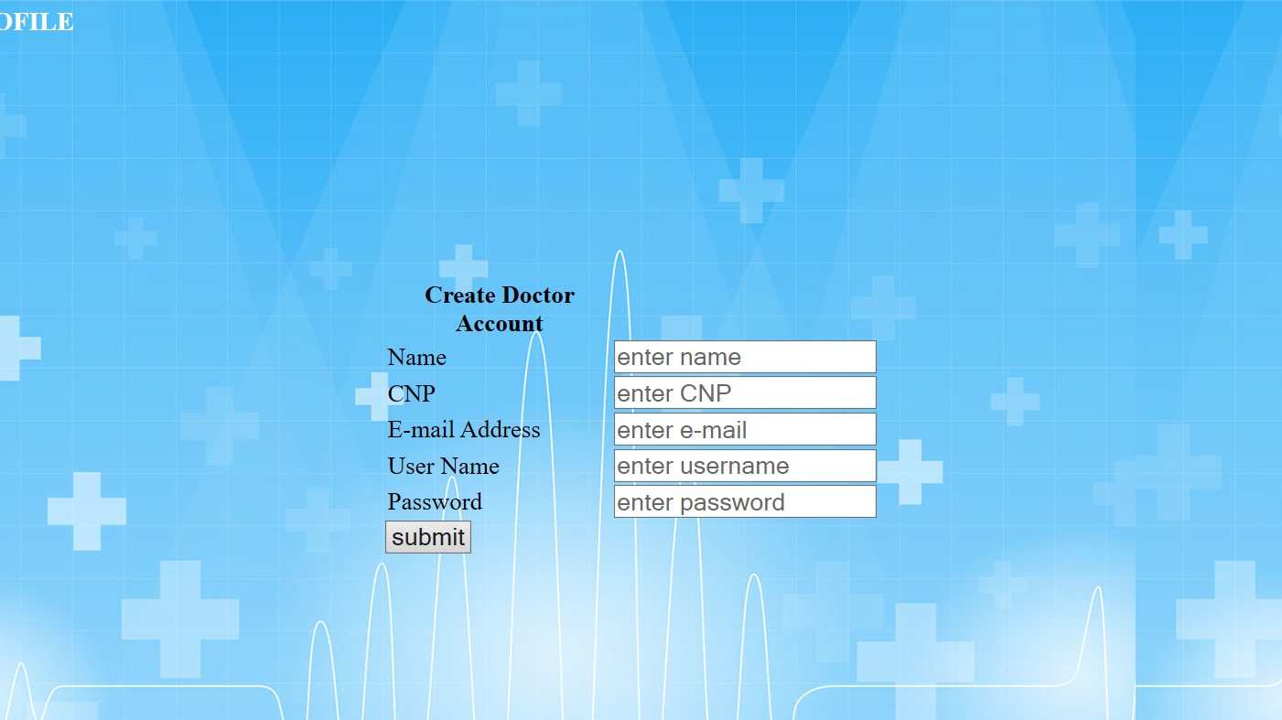
Create doctor account

Slide 13

Create admin account

Slide 14
Conclusions
The application is simple and provides easy access to all the necessary medical information for both medical personnel and patients.
The application facilitates the communication between the doctor and the patients.

Slide 15
Thank you for your attention!

